Slide 1

Life Expectancy Predictions
Analysis By:
Zack Lasek, Reed Foster, Jack Alberts, Alex Wallace
Notes:
Jack

Slide 2
Executive Summary
Problem Statement:
Can a country’s life expectancy be predicted based off of their countries development status, average BMI, Income Composition of Resources, Schooling and rate of measles?
Data Sources:
Kaggle: Statistical Analysis of Factors Influencing Life Expectancy (WHO)
Methods:
Multi-linear regression to find the parsimonious model
Measures:
Variables, P-Values, and Multicollinearity
Conclusions:
A model including the development status of a country in addition to their average amount of schooling can be used to reasonably predict life expectancy.
Notes:
Zack

Slide 3
Problem Statement:
Can life expectancy be predicted based off of a country’s development status, average BMI, income composition of resources, years of schooling and rate of measles?
What effect does development status have on life expectancy?
What effect does the rate of measles have on life expectancy?
What effect does BMI have on life expectancy?
What effect does amount of schooling have on life expectancy?
What effect does income composition of resources have on life expectancy?
Notes:
Reed
Once again, we came up with the problem statement: “Can life expectancy be predicted based off of a country’s development status, average BMI, income composition of resources, years of schooling and rate of measles?”
Thus, when conducting our research we wanted to find out whether each subset had a significant influence on people’s life expectancies across varying developing and developed countries provided in our data set.
These individual questions include:

Slide 4
Issues raised by TA about the proposal
Specific comments on the size of the dataset
Specific columns to be used.
Questions which can be applied to real-world understanding
Notes:
Jack

Slide 5
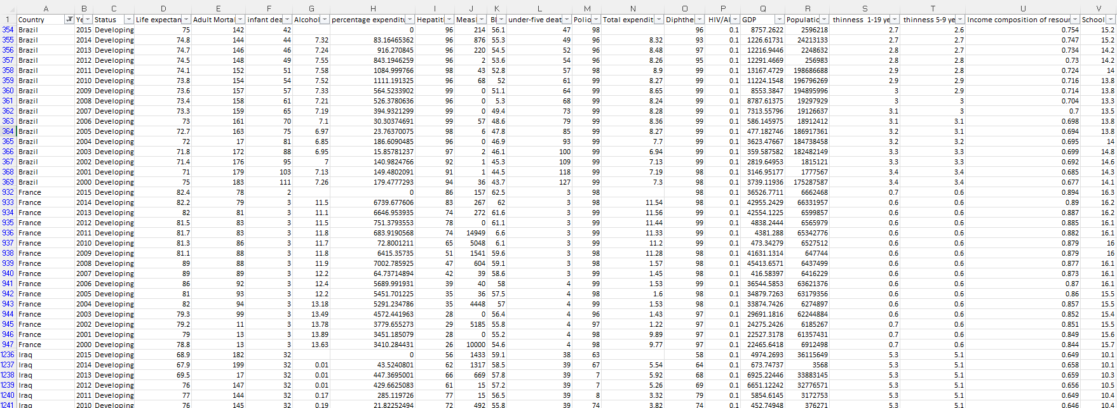
Original Dataset
The dataset observed is information from the WHO related to variables that may possibly relate to life expectancy in certain countries.
Our original dataset had 91 Rows and 22 Columns.
The rows consisted of 1 label row, and 90 rows containing data for each country for the span of 2000-2016.
Notes:
Alex

Slide 6
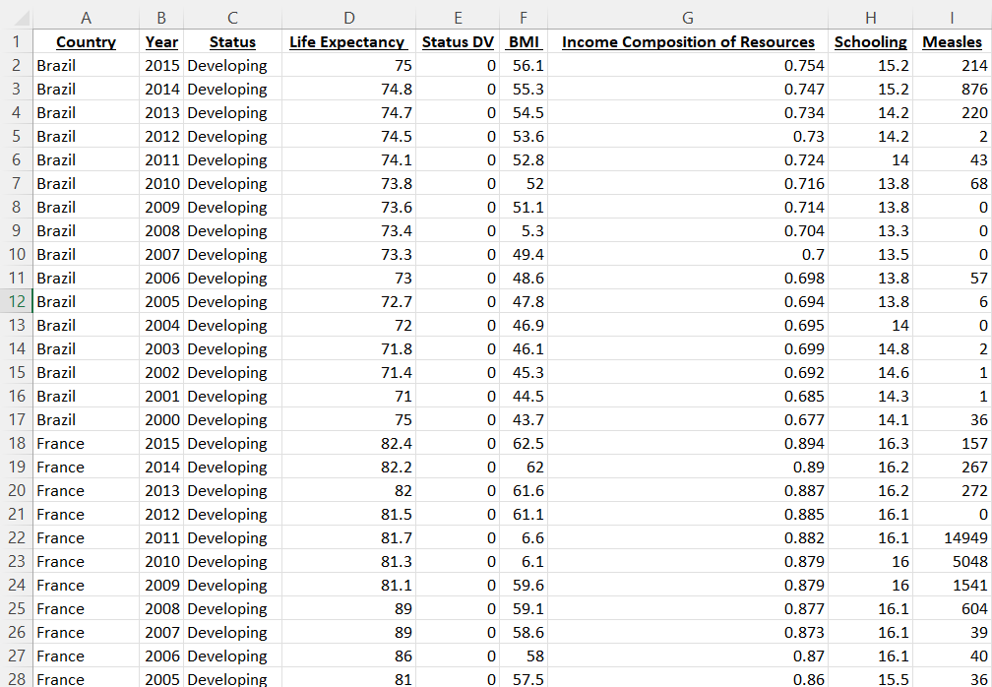
Refined Dataset
We chose certain variables we felt would have correlation to life expectancy and were left with 91 Rows and 9 Columns. The variables selected were:
Development status, average BMI, Income Composition of Resources, Schooling and rate of measles
We then added a dummy variable for Development Status
1 = Developed, 0 = Developing
Limitations:
Does not include all countries of the world.
We narrowed down our dependent variables to 5 we thought would have the highest impact.
Multiple countries may have the same development status.
Notes:
Zack

Slide 7
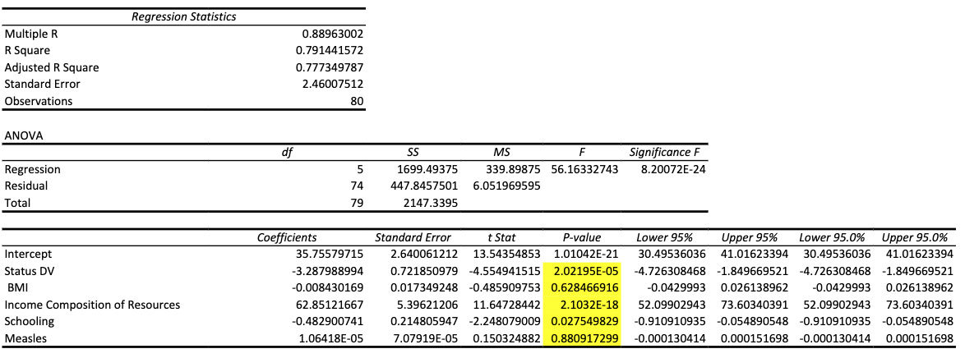
Regression 1 Explanation (before multicollinearity adjustment)
After running our first regression analysis, b5 ( measles) provided a p value > .05, therefore it is insignificant and must be removed from our model.
Meales being insignificant and the first to be dropped makes sense because it is not as big of a deal with the current technological and medical structures in place even in developing countries like Iraq and Brazil.
Notes:
Reed

Slide 8
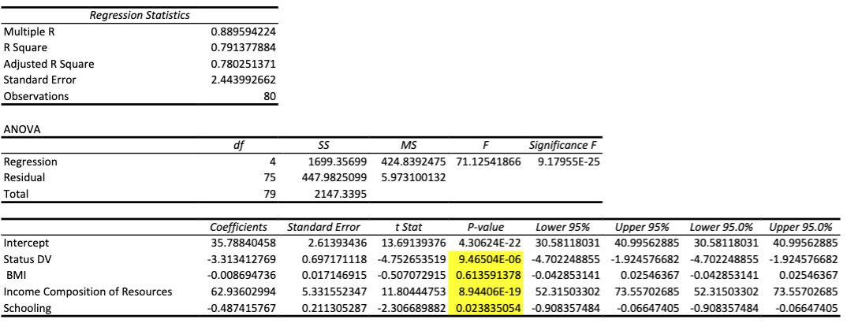
Regression 2 Explanation (before multicollinearity adjustment)
The “BMI” variable turned out to be insignificant (.6136>.05)
The insignificant variable needed to be removed for our next model.
Notes:
Jack

Slide 9
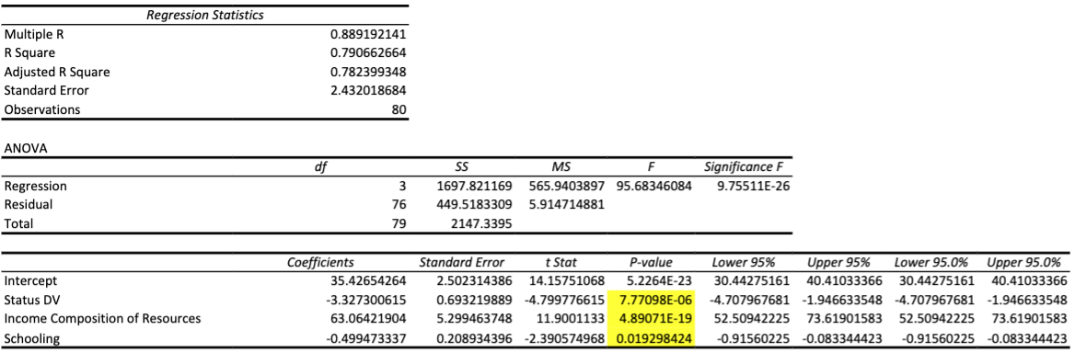
Regression 3 Explanation (before multicollinearity adjustment)
Removed the BMI variable
Ran new regression and found all variables to be significant
Not our final model → multicollinearity
Notes:
Alex

Slide 10
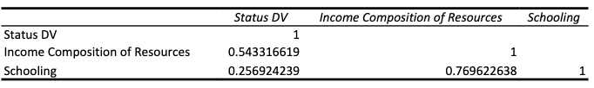
Collinearity
Notes:
Zack

Slide 11
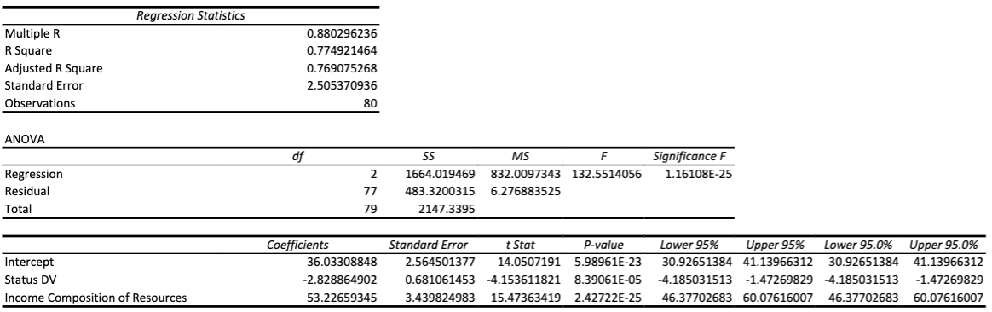
Final Model
Final Equation: (Y) Life Expectancy = 36.033 + (Status * -2.829) + (ICR * 53.227)
Notes:
Alex

Slide 12
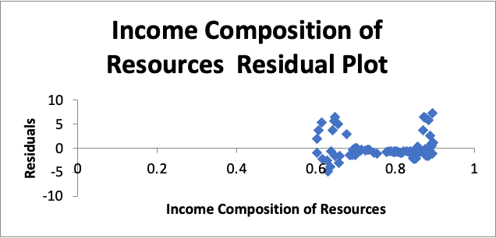
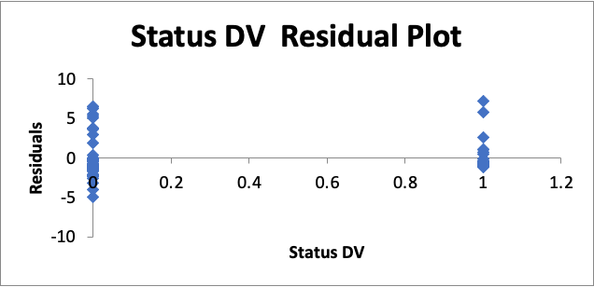
Residual Plots
Income Composition of Resources: Our residual plot for Income seems to be centered around zero and has good variability.
Status of Development: With 0 as the “Developing” variable and 1 as the “Developed” variable, it makes sense that all of our points are plotted on 0 or 1. The points seem to be evenly distributed and there is no unusual pattern.
Notes:
Jack

Slide 13
Conclusions
Problem: Can life expectancy be predicted based off of a country’s development status, average BMI, income composition of resources, years of schooling, and rate of measles?
Conclusion: We were able to find a model that can be used to predict the life expectancy of a country to a reasonable degree using the development status and income composition of resources as independent variables with an r-squared value of 77.49%.
Notes:
Reed

Slide 14
References
Jashi, Kumarra. (2018). Statistical Analysis on Factors Influencing Life Expectancy. [Life Expectancy
WHO]. https://www.kaggle.com/datasets/kumarajarshi/life-expectancy-who
Online Audio Converter - Сonvert audio files to MP3, WAV, MP4, M4A, OGG or iPhone Ringtones (online-audio-converter.com)

